Slide 1
MODULE – 5 TRANSACTION PROCESSING
INTRODUCTION TO TRANSACTION PROCESSING
CONCURRENCY CONTROL IN DATABASES
INTRODUCTION TO DATABASE RECOVERY PROTOCOLS
Prepared by Mushtaq Ahmed D Assistant Professor, Dept. of ISE

Slide 2
Introduction to Transaction Processing
Transaction: An executing program (process) that includes one or more database access operations
Read operations (database retrieval, such as SQL SELECT)
Write operations (modify database, such as SQL INSERT, UPDATE, DELETE)
Transaction: A logical unit of database processing
Example: Bank balance transfer of $100 dollars from a checking account to a saving account in a BANK database
Note: Each execution of a program is a distinct transaction with different parameters
Bank transfer program parameters: savings account number, checking account number, transfer amount

Slide 3
Introduction to Transaction Processing (cont.)
A transaction (set of operations) may be:
stand-alone, specified in a high level language like SQL submitted interactively, or
consist of database operations embedded within a program (most transactions)
Transaction boundaries: Begin and End transaction.
Note: An application program may contain several transactions separated by Begin and End transaction boundaries

Slide 4
Introduction to Transaction Processing (cont.)
Transaction Processing Systems: Large multi-user database systems supporting thousands of concurrent transactions (user processes) per minute
Two Modes of Concurrency
Interleaved processing: concurrent execution of processes is interleaved in a single CPU
Parallel processing: processes are concurrently executed in multiple CPUs (Figure)
Basic transaction processing theory assumes interleaved concurrency

Slide 5
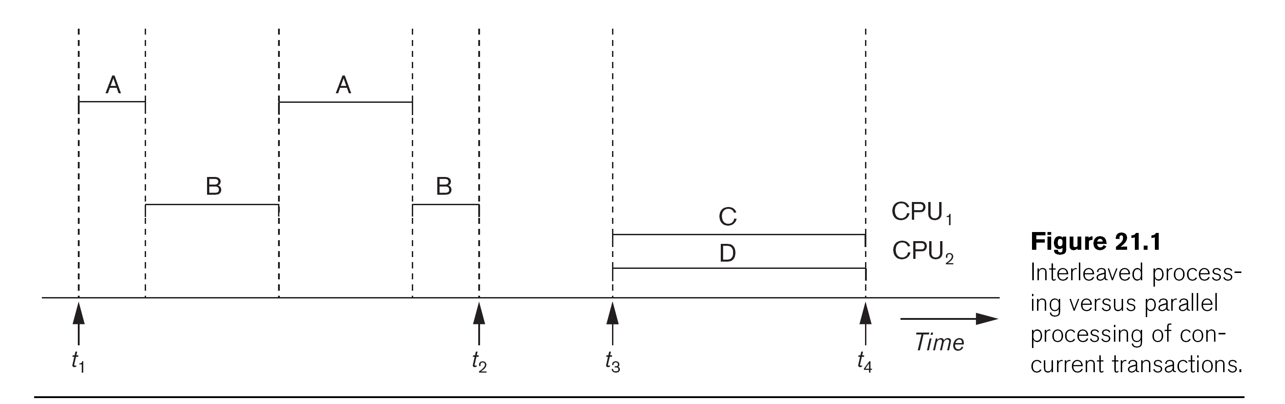

Slide 6
Introduction to Transaction Processing (cont.)
For transaction processing purposes, a simple database model is used:
A database - collection of named data items
Granularity (size) of a data item - a field (data item value), a record, or a whole disk block
TP concepts are independent of granularity
Basic operations on an item X:
read_item(X): Reads a database item named X into a program variable. To simplify our notation, we assume that the program variable is also named X.
write_item(X): Writes the value of program variable X into the database item named X.

Slide 7
Introduction to Transaction Processing (cont.)
READ AND WRITE OPERATIONS:
Basic unit of data transfer from the disk to the computer main memory is one disk block (or page). A data item X (what is read or written) will usually be the field of some record in the database, although it may be a larger unit such as a whole record or even a whole block.
read_item(X) command includes the following steps:
Find the address of the disk block that contains item X.
Copy that disk block into a buffer in main memory (if that disk block is not already in some main memory buffer).
Copy item X from the buffer to the program variable named X.

Slide 8
Introduction to Transaction Processing (cont.)
READ AND WRITE OPERATIONS (cont.):
write_item(X) command includes the following steps:
Find the address of the disk block that contains item X.
Copy that disk block into a buffer in main memory (if it is not already in some main memory buffer).
Copy item X from the program variable named X into its correct location in the buffer.
Store the updated block from the buffer back to disk (either immediately or at some later point in time).

Slide 9
Transaction Notation
Figure (next slide) shows two examples of transactions
Notation focuses on the read and write operations
Can also write in shorthand notation:
T1: b1; r1(X); w1(X); r1(Y); w1(Y); e1;
T2: b2; r2(Y); w2(Y); e2;
bi and ei specify transaction boundaries (begin and end)
i specifies a unique transaction identifier (TId)

Slide 11
Why we need concurrency control
Without Concurrency Control, problems may occur with concurrent transactions:
Lost Update Problem.
Occurs when two transactions update the same data item, but both read the same original value before update (Figure (a), next slide)
The Temporary Update (or Dirty Read) Problem.
This occurs when one transaction T1 updates a database item X, which is accessed (read) by another transaction T2; then T1 fails for some reason (Figure (b)); X was (read) by T2 before its value is changed back (rolled back or UNDONE) after T1 fails

Slide 13
Why we need concurrency control (cont.)
The Incorrect Summary Problem
One transaction is calculating an aggregate summary function on a number of records (for example, sum (total) of all bank account balances) while other transactions are updating some of these records (for example, transferring a large amount between two accounts); the aggregate function may read some values before they are updated and others after they are updated.

Slide 15
Why we need concurrency control (cont.)
The Unrepeatable Read Problem
A transaction T1 may read an item (say, available seats on a flight); later, T1 may read the same item again and get a different value because another transaction T2 has updated the item (reserved seats on the flight) between the two reads by T1

Slide 16
Why recovery is needed
Causes of transaction failure:
A computer failure (system crash): A hardware or software error occurs during transaction execution. If the hardware crashes, the contents of the computer’s internal main memory may be lost.
2. A transaction or system error : Some operation in the transaction may cause it to fail, such as integer overflow or division by zero. Transaction failure may also occur because of erroneous parameter values or because of a logical programming error. In addition, the user may interrupt the transaction during its execution.

Slide 17
Why recovery is needed (cont.)
3. Local errors or exception conditions detected by the transaction:
certain conditions necessitate cancellation of the transaction. For example, data for the transaction may not be found. A condition, such as insufficient account balance in a banking database, may cause a transaction, such as a fund withdrawal, to be canceled - a programmed abort causes the transaction to fail.
4. Concurrency control enforcement: The concurrency control method may decide to abort the transaction, to be restarted later, because it violates serializability or because several transactions are in a state of deadlock (see Chapter 22).

Slide 18
Why recovery is needed (cont.)
5. Disk failure: Some disk blocks may lose their data because of a read or write malfunction or because of a disk read/write head crash. This kind of failure and item 6 are more severe than items 1 through 4.
6. Physical problems and catastrophes: This refers to an endless list of problems that includes power or air-conditioning failure, fire, theft, sabotage, overwriting disks or tapes by mistake, and mounting of a wrong tape by the operator.

Slide 19
Transaction and System Concepts
A transaction is an atomic unit of work that is either completed in its entirety or not done at all. A transaction passes through several states (Figure 21.4, similar to process states in operating systems).
Transaction states:
Active state (executing read, write operations)
Partially committed state (ended but waiting for system checks to determine success or failure)
Committed state (transaction succeeded)
Failed state (transaction failed, must be rolled back)
Terminated State (transaction leaves system)

Slide 21
Transaction and System Concepts (cont.)
DBMS Recovery Manager needs system to keep track of the following operations (in the system log file):
begin_transaction: Start of transaction execution.
read or write: Read or write operations on the database items that are executed as part of a transaction.
end_transaction: Specifies end of read and write transaction operations have ended. System may still have to check whether the changes (writes) introduced by transaction can be permanently applied to the database (commit transaction); or whether the transaction has to be rolled back (abort transaction) because it violates concurrency control or for some other reason.

Slide 22
Transaction and System Concepts (cont.)
Recovery manager keeps track of the following operations (cont.):
commit_transaction: Signals successful end of transaction; any changes (writes) executed by transaction can be safely committed to the database and will not be undone.
abort_transaction (or rollback): Signals transaction has ended unsuccessfully; any changes or effects that the transaction may have applied to the database must be undone.

Slide 23
Transaction and System Concepts (cont.)
System operations used during recovery
undo(X): Similar to rollback except that it applies to a single write operation rather than to a whole transaction.
redo(X): This specifies that a write operation of a committed transaction must be redone to ensure that it has been applied permanently to the database on disk.

Slide 24
Transaction and System Concepts (cont.)
The System Log File
Is an append-only file to keep track of all operations of all transactions in the order in which they occurred. This information is needed during recovery from failures
Log is kept on disk - not affected except for disk or catastrophic failure
As with other disk files, a log main memory buffer is kept for holding the records being appended until the whole buffer is appended to the end of the log file on disk
Log is periodically backed up to archival storage (tape) to guard against catastrophic failures

Slide 25
Transaction and System Concepts (cont.)
Types of records (entries) in log file:
[start_transaction,T]: Records that transaction T has started execution.
[write_item,T,X,old_value,new_value]: T has changed the value of item X from old_value to new_value.
[read_item,T,X]: T has read the value of item X (not needed in many cases).
[end_transaction,T]: T has ended execution
[commit,T]: T has completed successfully, and committed.
[abort,T]: T has been aborted.

Slide 26
Transaction and System Concepts (cont.)
The System Log (cont.):
protocols for recovery that avoid cascading rollbacks do not require that read operations be written to the system log; most recovery protocols fall in this category.
strict protocols require simpler write entries that do not include new value.

Slide 27
Transaction and System Concepts (cont.)
Commit Point of a Transaction:
A transaction T reaches its commit point when all its operations that access the database have been executed successfully and the effect of all the transaction operations on the database has been recorded in the log file (on disk). The transaction is then said to be committed.

Slide 28
Transaction and System Concepts (cont.)
Commit Point of a Transaction (cont.):
Log file buffers: Like database files on disk, whole disk blocks must be read or written to main memory buffers.
For log file, the last disk block (or blocks) of the file will be in main memory buffers to easily append log entries at end of file.
Force writing the log buffer: before a transaction reaches its commit point, any main memory buffers of the log that have not been written to disk yet must be copied to disk.
Called force-writing the log buffers before committing a transaction.
Needed to ensure that any write operations by the transaction are recorded in the log file on disk before the transaction commits

Slide 29
Desirable Properties of Transactions
ACID properties:
Atomicity
Consistency
Isolation
Durability
Atomicity: A transaction is an atomic unit of processing; it is either performed in its entirety or not performed at all.
Consistency preservation: A correct execution of the transaction must take the database from one consistent state to another.

Slide 30
Desirable Properties of Transactions (cont.)
ACID properties (cont.):
Isolation: Even though transactions are executing concurrently, they should appear to be executed in isolation – that is, their final effect should be as if each transaction was executed in isolation from start to finish.
Durability or permanency: Once a transaction is committed, its changes (writes) applied to the database must never be lost because of subsequent failure.

Slide 31
Desirable Properties of Transactions (cont.)
Atomicity: Enforced by the recovery protocol.
Consistency preservation: Specifies that each transaction does a correct action on the database on its own. Application programmers and DBMS constraint enforcement are responsible for this.
Isolation: Responsibility of the concurrency control protocol.
Durability or permanency: Enforced by the recovery protocol.

Slide 32
Purpose of Concurrency Control
To ensure that the Isolation Property is maintained while allowing transactions to execute concurrently (outcome of concurrent transactions should appear as though they were executed in isolation).
To preserve database consistency by ensuring that the schedules of executing transactions are serializable.
To resolve read-write and write-write conflicts among transactions.

Slide 33
Concurrency Control Protocols (CCPs)
A CCP is a set of rules enforced by the DBMS to ensure serializable schedules
Also known as CCMs (Concurrency Control Methods)
Main protocol known as 2PL (2-phase locking), which is based on locking the data items
Other protocols use different techniques
We first cover 2PL in some detail, then give an overview of other techniques

Slide 34
2PL Concurrency Control Protocol
Based on each transaction securing a lock on a data item before using it:
Locking enforces mutual exclusion when accessing a data item – simplest kind of lock is a binary lock, which secures permission to Read or Write a data item for a transaction.
Example: If T1 requests Lock(X) operation, the system grants the lock unless item X is already locked by another transaction. If request is granted, data item X is locked on behalf of the requesting transaction T1.
Unlocking operation removes the lock.
Example: If T1 issues Unlock (X), data item X is made available to all other transactions.

Slide 35
2PL Concurrency Control Protocol
System maintains lock table to keep track of which items are locked by which transactions
Lock(X) and Unlock (X) are hence system calls
Transactions that request a lock but do not have it granted can be placed on a waiting queue for the item
Transaction T must unlock any items it had locked before T terminates
Next slides gives overview of lock and unlock operations

Slide 36
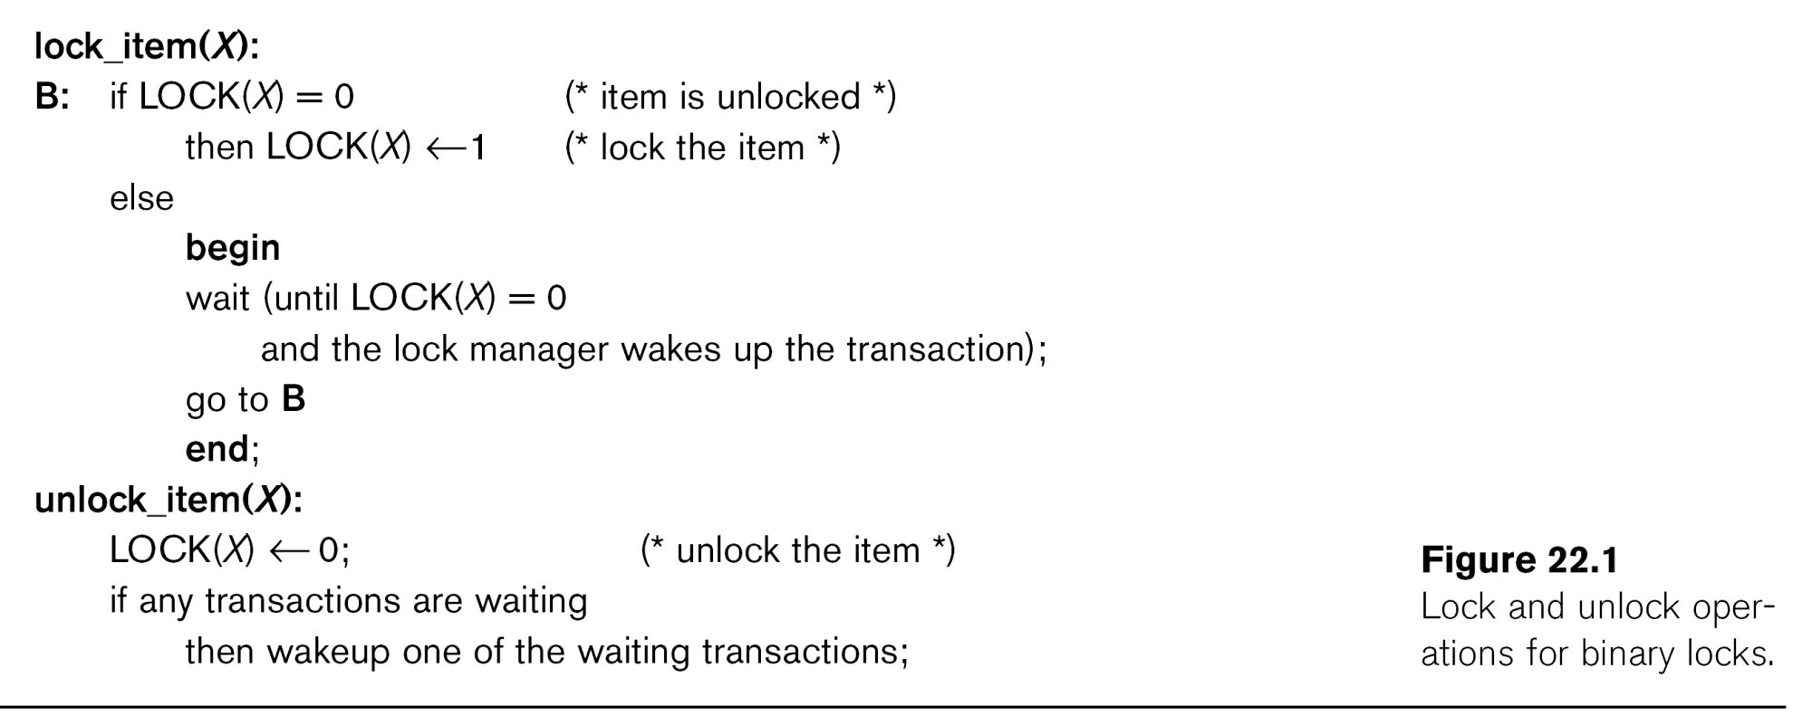

Slide 37
2PL Concurrency Control (cont.)
Locking for database items:
For database purposes, binary locks are not sufficient:
Two locks modes are needed (a) shared lock (read lock) and (b) exclusive lock (write lock).
Shared mode: Read lock (X). Several transactions can hold shared lock on X (because read operations are not conflicting).
Exclusive mode: Write lock (X). Only one write lock on X can exist at any time on an item X. (No read or write locks on X by other transactions can exist).
Conflict matrix

Slide 38
2PL Concurrency Control (cont.)
Three operations are now needed:
read_lock(X): transaction T requests a read (shared) lock on item X
write_lock(X): transaction T requests a write (exclusive) lock on item X
unlock(X): transaction T unlocks an item that it holds a lock on (shared or exclusive)
Transaction can be blocked (forced to wait) if the item is held by other transactions in conflicting lock mode
Conflicts are write-write or read-write (read-read is not conflicting)
Next slide gives outline of these three operations

Slide 40
2PL Concurrency Control (cont.)
Two-Phase Locking Techniques: Essential components
Lock Manager: Subsystem of DBMS that manages locks on data items.
Lock table: Lock manager uses it to store information about locked data items, such as: data item id, transaction id, lock mode, list of waiting transaction ids, etc. One simple way to implement a lock table is through linked list (shown). Alternatively, a hash table with item id as hash key can be used.

Slide 41
2PL Concurrency Control (cont.)
Rules for locking:
Transaction must request appropriate lock on a data item X before it reads or writes X.
If T holds a write (exclusive) lock on X, it can both read and write X.
If T holds a read lock on X, it can only read X.
T must unlock all items that it holds before terminating
(also T cannot unlock X unless it holds a lock on X).

Slide 42
2PL Concurrency Control (cont.)
Lock conversion
Lock upgrade: existing read lock to write lock
if Ti holds a read-lock on X, and no other Tj holds a read-lock on X (i ≠ j), then
it is possible to convert (upgrade) read-lock(X) to write-lock(X)
else
force Ti to wait until all other transactions Tj that hold read locks on X release their locks
Lock downgrade: existing write lock to read lock
if Ti holds a write-lock on X
(*this implies that no other transaction can have any lock on X*)
then it is possible to convert (downgrade) write-lock(X) to read-lock(X)

Slide 43
2PL Concurrency Control (cont.)
Two-Phase Locking Rule:
Each transaction should have two phases: (a) Locking (Growing) phase, and (b) Unlocking (Shrinking) Phase.
Locking (Growing) Phase: A transaction applies locks (read or write) on desired data items one at a time. Can also try to upgrade a lock.
Unlocking (Shrinking) Phase: A transaction unlocks its locked data items one at a time. Can also downgrade a lock.
Requirement: For a transaction these two phases must be mutually exclusively, that is, during locking phase no unlocking or downgrading of locks can occur, and during unlocking phase no new locking or upgrading operations are allowed.

Slide 44
2PL Concurrency Control (cont.)
Basic Two Phase Locking:
When transaction starts executing, it is in the locking phase, and it can request locks on new items or upgrade locks. A transaction may be blocked (forced to wait) if a lock request is not granted. (This may lead to several transactions being in a state of deadlock – see later)
Once the transaction unlocks an item (or downgrades a lock), it starts its shrinking phase and can no longer upgrade locks or request new locks.
The combination of locking rules and 2-phase rule ensures serializable schedules
Theorem: If every transaction in a schedule follows the 2PL rules, the schedule must be serializable. (Proof is by contradiction.)

Slide 45
2PL Concurrency Control (cont.)
Some Examples:
Rules of locking alone do not enforce serializability – Figure 22.3(c) shows a schedule that follows locking rules but is not serializable
Figure 22.4 shows how the transactions in Figure 22.3(a) can be modified to follow the two-phase rule (by delaying the first unlock operation till all locking is completed).
The schedule in 22.3(c) would not be allowed if the transactions are changed as in 22.4 – a state of deadlock would occur instead because T2 would try to lock Y (which is locked by T1 in conflicting mode) and forced to wait, then T1 would try to lock X (which is locked by T2 in conflicting mode) and forced to wait – neither transaction can continue to unlock the item they hold as they are both blocked (waiting) – see Figure 22.5

Slide 47
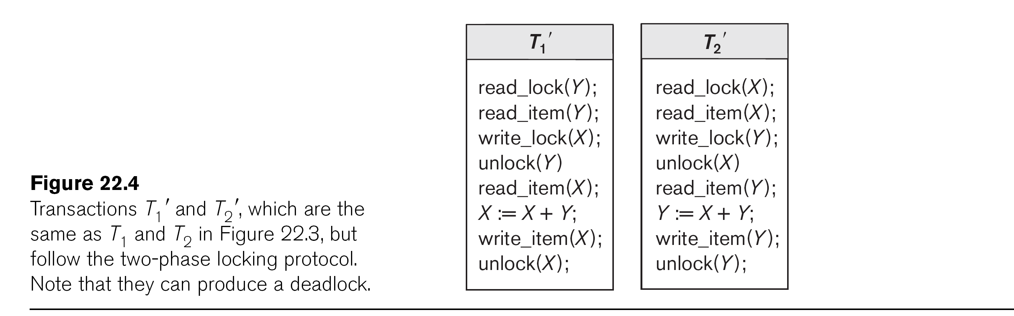

Slide 48
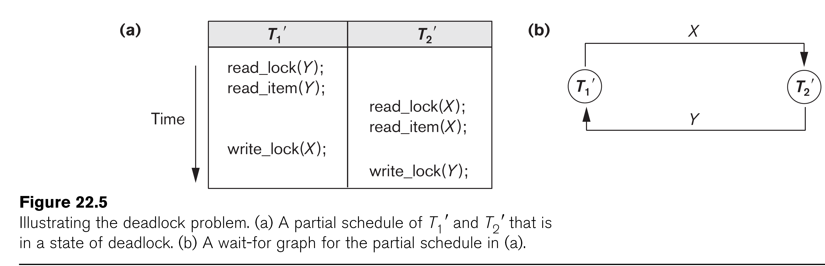

Slide 49
2PL Concurrency Control (cont.)
Other Variations of Two-Phase Locking:
Conservative 2PL: A transaction must lock all its items before starting execution. If any item it needs is not available, it locks no items and tries again later. Conservative 2PL has no deadlocks since no lock requests are issued once transaction execution starts.
Strict 2PL: All items that are writelocked by a transaction are not released (unlocked) until after the transaction commits. This is the most commonly used two-phase locking algorithm, and ensures strict schedules (for recoverability).
Rigorous 2PL: All items that are writelocked or readlocked by a transaction are not released (unlocked) until after the transaction commits. Also guarantees strict schedules.

Slide 50
2PL Concurrency Control (cont.)
Deadlock Example (see Figure 22.5)
T1' T2'
read_lock (Y); T1' and T2' did follow two-phase
read_item (Y); policy but they are deadlock
read_lock (X);
read_item (Y);
write_lock (X);
(waits for X) write_lock (Y);
(waits for Y)
Deadlock (T1' and T2')

Slide 51
2PL Concurrency Control (cont.)
Dealing with Deadlock
Deadlock prevention
System enforces additional rules (deadlock prevention protocol) to ensure deadlock do not occur – many protocols (see later for some examples)
Deadlock detection and resolution
System checks for a state of deadlock – if a deadlock exists, one of the transactions involved in the deadlock is aborted

Slide 52
2PL Concurrency Control (cont.)
1. Deadlock detection and resolution
In this approach, deadlocks are allowed to happen. The system maintains a wait-for graph for detecting cycles. If a cycle exists, then one transaction involved in the cycle is selected (victim) and rolled-back (aborted).
A wait-for graph contains a node for each transaction. When a transaction (say Ti) is blocked because it requests an item X held by another transaction Tj in conflicting mode, a directed edge is created from Ti to Tj (Ti is waiting on Tj to unlock the item). The system checks for cycles; if a cycle exists, a state of deadlock is detected (see Figure 22.5).

Slide 53
2PL Concurrency Control (cont.)
2. Deadlock prevention
There are several protocols. Some of them are:
1. Conservative 2PL, as we discussed earlier.
2. No-waiting protocol: A transaction never waits; if Ti requests an item that is held by Tj in conflicting mode, Ti is aborted. Can result in needless transaction aborts because deadlock might have never occurred
3. Cautious waiting protocol: If Ti requests an item that is held by Tj in conflicting mode, the system checks the status of Tj; if Tj is not blocked, then Ti waits – if Tj is blocked, then Ti aborts. Reduces the number of needlessly aborted transactions

Slide 54
2PL Concurrency Control (cont.)
2. Deadlock prevention (cont.)
4. Wound-wait and wait-die: Both use transaction timestamp TS(T), which is a monotonically increasing unique id given to each transaction based on their starting time
TS(T1) < TS(T2) means that T1 started before T2 (T1 older than T2)
(Can also say T2 younger than T1)
Wait-die:
If Ti requests an item X that is held by Tj in conflicting mode, then
if TS(Ti) < TS(Tj) then Ti waits (on a younger transaction Tj)
else Ti dies (if Ti is younger than Tj, it aborts)
[In wait-die, transactions only wait on younger transactions that started later, so no cycle ever occurs in wait-for graph – if transaction requesting lock is younger than that holding the lock, requesting transaction aborts (dies)]

Slide 55
2PL Concurrency Control (cont.)
2. Deadlock prevention (cont.)
4. Wound-wait and wait-die (cont.):
Wound-wait:
If Ti requests an item X that is held by Tj in conflicting mode, then
if TS(Ti) < TS(Tj) then Tj is aborted (Ti wounds younger Tj)
else Ti waits (on an older transaction Tj)
[In wound-wait, transactions only wait on older transactions that started earlier, so no cycle ever occurs in wait-for graph – if transaction requesting lock is older than that holding the lock, transaction holding the lock is preemptively aborted]

Slide 56
Database Concurrency Control
Dealing With Starvation
Starvation occurs when a particular transaction consistently waits or gets restarted and never gets a chance to proceed further. Solution is to use a fair priority-based scheme that increases the priority for transaction the longer they wait.
Examples of Starvation:
1. In deadlock detection/resolution it is possible that the same transaction may consistently be selected as victim and rolled-back.
2. In conservative 2PL, a transaction may never get started because all the items needed are never available at the same time.
3. In Wound-Wait scheme a younger transaction may always be wounded (aborted) by a long running older transaction which may create starvation.

Slide 57
Other Concurrency Control Methods
Some CCMs other than 2PL:
Timestamp Ordering (TO) CCM
Optimistic (Validation-Based) CCMs
Multi-version CCMs:
Multiversion 2PL with Certify Locks
Multiversion TO

Slide 58
Purpose of Database Recovery
To bring the database into a consistent state after a failure occurs.
To ensure the transaction properties of Atomicity (a transaction must be done in its entirety; otherwise, it has to be rolled back) and Durability (a committed transaction cannot be canceled and all its updates must be applied permanently to the database).
After a failure, the DBMS recovery manager is responsible for bringing the system into a consistent state before transactions can resume.

Slide 59
Types of Failure
Transaction failure: Transactions may fail because of errors, incorrect input, deadlock, incorrect synchronization, etc.
System failure: System may fail because of application error, operating system fault, RAM failure, etc.
Media failure: Disk head crash, power disruption, etc.

Slide 60
The Log File
Holds the information that is necessary for the recovery process
Records all relevant operations in the order in which they occur (looks like a schedule of transactions, see Chapter 21)
Is an append-only file.
Holds various types of log records (or log entries).

Slide 61
Log File Entries (from Chapter 21)
Types of records (entries) in log file:
[start_transaction,T]: Records that transaction T has started execution.
[write_item,T,X,old_value,new_value]: T has changed the value of item X from old_value to new_value.
[read_item,T,X]: T has read the value of item X (not needed in many cases).
[end_transaction,T]: T has ended execution
[commit,T]: T has completed successfully, and committed.
[abort,T]: T has been aborted.

Slide 62
The Log File (cont.)
For write_item log entry, old value of item before modification (BFIM - BeFore Image) and the new value after modification (AFIM – AFter Image) are stored. BFIM needed for UNDO, AFIM needed for REDO. A sample log is given below. Back P and Next P point to the previous and next log records of the same transaction.

Slide 63
Database Cache
Database Cache: A set of main memory buffers; each buffer typically holds contents of one disk block. Stores the disk blocks that contain the data items being read and written by the database transactions.
Data Item Address: (disk block address, offset, size in bytes).
Cache Table:Table of entries of the form (buffer addr, disk block addr, modified bit, pin/unpin bit, ...) to indicate which disk blocks are currently in the cache buffers.

Slide 64
Database Cache (cont.)
Data items to be modified are first copied into database cache by the Cache Manager (CM) and after modification they are flushed (written) back to the disk. The flushing is controlled by Modified and Pin-Unpin bits.
Pin-Unpin: If a buffer is pinned, it cannot be written back to disk until it is unpinned.
Modified: Indicates that one or more data items in the buffer have been changed.

Slide 65
Data Update
Immediate Update: A data item modified in cache can be written back to disk before the transaction commits.
Deferred Update: A modified data item in the cache cannot be written back to disk till after the transaction commits (buffer is pinned).
Shadow update: The modified version of a data item does not overwrite its disk copy but is written at a separate disk location (new version).
In-place update: The disk version of the data item is overwritten by the cache version.

Slide 66
UNDO and REDO Recovery Actions
To maintain atomicity and durability, some transaction’s may have their operations redone or undone during recovery. UNDO (roll-back) is needed for transactions that are not committed yet. REDO (roll-forward) is needed for committed transactions whose writes may have not yet been flushed from cache to disk.
Undo: Restore all BFIMs from log to database on disk. UNDO proceeds backward in log (from most recent to oldest UNDO).
Redo: Restore all AFIMs from log to database on disk. REDO proceeds forward in log (from oldest to most recent REDO).

Slide 67
Write-ahead Logging Protocol
The information needed for recovery must be written to the log file on disk before changes are made to the database on disk. Write-Ahead Logging (WAL) protocol consists of two rules:
For Undo: Before a data item’s AFIM is flushed to the database on disk (overwriting the BFIM) its BFIM must be written to the log and the log must be saved to disk.
For Redo: Before a transaction executes its commit operation, all its AFIMs must be written to the log and the log must be saved on a stable store.

Slide 68
Deferred Update (NO-UNDO/REDO) Recovery Protocol
System must impose NO-STEAL rule. Recovery subsystem analyzes the log, and creates two lists:
Active Transaction list: All active (uncommitted) transaction ids are entered in this list.
Committed Transaction list: Transactions committed after the last checkpoint are entered in this table.
During recovery, transactions in commit list are redone; transactions in active list are ignored (because of NO-STEAL rule, none of their writes have been applied to the database on disk). Some transactions may be redone twice; this does not create inconsistency because REDO is “idempotent”, that is, one REDO for an AFIM is equivalent to multiple REDO for the same AFIM.

Slide 69
Deferred Update (NO-UNDO/REDO) Recovery Protocol (cont.)
Advantage: Only REDO is needed during recovery.
Disadvantage: Many buffers may be pinned while waiting for transactions that updated them to commit, so system may run out of cache buffers when requests are made by new transactions.

Slide 70
UNDO/NO-REDO Recovery Protocol
In this method, FORCE rule is imposed by system (AFIMs of a transaction are flushed to the database on disk under Write Ahead Logging before the transaction commits).
Transactions in active list are undone; transactions in committed list are ignored (because based on FORCE rule, all their changes are already written to the database on disk).
Advantage: During recovery, only UNDO is needed.
Disadvantages: 1. Commit of a transaction is delayed until all its changes are force-written to disk. 2. Some buffers may be written to disk multiple times if they are updated by several transactions.

Slide 71
UNDO/REDO Recovery Protocol
Recovery can require both UNDO of some transactions and REDO of other transactions (Corresponds to STEAL/NO-FORCE). Used most often in practice because of disadvantages of the other two methods. To minimize REDO, checkpointing is used. The recovery performs:
Undo of a transaction if it is in the active transaction list.
Redo of a transaction if it is in the list of transactions that committed since the last checkpoint.

Slide 72
Why NoSQL?
Flexibility: In general, NoSQL databases have flexible structures that allow for rapid and much more iterative improvement. Because of its flexible data format, NoSQL databases are suitable for semi-structured and unstructured information.
Scalability: NoSQL databases are usually designed to expand by employing dispersed hardware groups rather than expanding higher by introducing costly and resilient servers. Like a service software, several cloud services perform these activities behind the lines.
High-performance: NoSQL databases are designed for specific data structures and associated metadata, resulting in faster responsiveness than attempting to provide equivalent functionality using relational databases.
Enhanced functionality: NoSQL databases offer purpose-built data types which offer distinct data models and also a highly functioning Interfaces.

Slide 73
Characteristics of NoSQL
it’s more than rows in tables—NoSQL systems store and retrieve data from many formats: key-value stores, graph databases, column-family (Bigtable) stores, document stores, and even rows in tables.
It’s free of joins—NoSQL systems allow you to extract your data using simple interfaces without joins.
It’s schema-free—NoSQL systems allow you to drag-and-drop your data into a folder and then query it without creating an entity-relational model.
It works on many processors—NoSQL systems allow you to store your database on multiple processors and maintain high-speed performance.
It uses shared-nothing commodity computers—Most (but not all) NoSQL systems leverage low-cost commodity processors that have separate RAM and disk.
It supports linear scalability—When you add more processors, you get a consistent increase in performance.
It’s innovative—NoSQL offers options to a single way of storing, retrieving, and manipulating data. NoSQL supporters (also known as NoSQLers) have an inclusive
attitude about NoSQL and recognize SQL solutions as viable options. To the NoSQL community, NoSQL means “Not only SQL.”

Slide 74
Use of NoSQL in industry
Session Store: Managing session data using relational database is very difficult, especially in case where applications are grown very much.
User Profile Store: To enable online transactions, user preferences, authentication of user and more, it is required to store the user profile by web and mobile application.
Content and Metadata Store: Many companies like publication houses require a place where they can store large amount of data, which include articles, digital content and e-books, in order to merge various tools for learning in single platform
Mobile Applications: Since the smartphone users are increasing very rapidly, mobile applications face problems related to growth and volume.
Third-Party Data Aggregation: Frequently a business require to access data produced by third party. For instance, a consumer packaged goods company may require to get sales data from stores as well as shopper’s purchase history.

Slide 75
Use of NoSQL in industry
Internet of Things: Today, billions of devices are connected to internet, such as smartphones, tablets, home appliances, systems installed in hospitals, cars and warehouses. For such devices large volume and variety of data is generated and keep on generating.
E-Commerce
E-commerce companies use NoSQL for store huge volume of data and large amount of request from user.
Social GamingData-intensive applications such as social games which can grow users to millions. Such a growth in number of users as well as amount of data requires a database system which can store such data and can be scaled to incorporate number of growing users NOSQL is suitable for such applications.
Ad TargetingDisplaying ads or offers on the current web page is a decision with direct income To determine what group of users to target, on web page where to display ads, the platforms gathers behavioral and demographic characteristics of users.

Slide 76
SQL VS NoSQL
Index | SQL | NoSQL
1) | Databases are categorized as Relational Database Management System (RDBMS). | NoSQL databases are categorized as Non-relational or distributed database system.
2) | SQL databases have fixed or static or predefined schema. | NoSQL databases have dynamic schema.
3) | SQL databases display data in form of tables so it is known as table-based database. | NoSQL databases display data as collection of key-value pair, documents, graph databases or wide-column stores.
4) | SQL databases are vertically scalable. | NoSQL databases are horizontally scalable.
5) | SQL databases use a powerful language "Structured Query Language" to define and manipulate the data. | In NoSQL databases, collection of documents are used to query the data. It is also called unstructured query language. It varies from database to database.
6) | SQL databases are best suited for complex queries. | NoSQL databases are not so good for complex queries because these are not as powerful as SQL queries.
7) | SQL databases are not best suited for hierarchical data storage. | NoSQL databases are best suited for hierarchical data storage.
8) | MySQL, Oracle, Sqlite, PostgreSQL and MS-SQL etc. are the example of SQL database. | MongoDB, BigTable, Redis, RavenDB, Cassandra, Hbase, Neo4j, CouchDB etc. are the example of nosql database

Slide 77
MongoDB
MongoDB is a document database with the scalability and flexibility that you want with the querying and indexing that you need.
The MongoDB database has a flexible data model that enables you to store unstructured data, and it provides full indexing support, and replication with rich and intuitive APIs.

Slide 78
why is mongodb
here are four major reasons why MongoDB is being deployed more often. They are:
1. Flexibility:
MongoDB uses documents that can contain sub-documents in complex hierarchies making it expressive and flexible. MongoDB can map objects from any programming language, ensuring easy implementation and maintenance.
2. Flexible Query Model:
The user can selectively index some parts of each document or a query based on regular expressions, ranges, or attribute values, and have as many properties per object as needed by the application layer.
3. Native Aggregation:
Native aggregation allows users to extract and transform data from the database. The data can either be loaded into a new format or exported to other data sources.
4. Schema-less model:
Applications get the power and responsibility to interpret different properties found in a collection's documents.

